Slide 1
Exploratory Data Analysis

Slide 2


Agenda
What is Exploratory Data analysis?
Why EDA is important?
Visualization
Important charts for visualization.
Steps involved in EDA:-
Data Sourcing
Data Cleaning
Univariate analysis with visualization
Bivariate analysis with visualization
Derived Metrics

Slide 3

Data Analytics/Science Process
Exploratory Data Analysis
Raw Data Collected
Clean Dataset
Data is Processed
Models & Algorithms
Data Product
Visualize Report
Make Decisions
Reality

Slide 4

What is Exploratory Data Analysis
Exploratory Data Analysis is an approach to analyze the datasets to summarize their main characteristics in form of visual methods.
EDA is nothing but a data exploration technique to understand various aspects of the data.
The main aim of EDA is to obtain confidence in a data to an extent where we are ready to engage a machine learning model.
EDA is important to analyze the data it’s a first steps in data analysis process.
EDA give a basic idea to understand the data and make sense of the data to figure out the question you need to ask and find out the best way to manipulate the dataset to get the answer to your question.
Exploratory data analysis help us to finding the errors, discovering data, mapping out data structure, finding out anomalies.
Exploratory data analysis is important for business process because we are preparing dataset for deep thorough analysis that will detect you business problem.
EDA help to build a quick and dirty model, or a baseline model, which can serve as a comparison against later models that you will build.

Slide 5





Visualization
Visualization is the presentation of the data in the graphical or visual form to understand the data more clearly. Visualization is easy to understand the data
Easily understand the features of the data
Easily analyze the data and summarize it.
Help to get meaningful insights from the data.
Help to find the trend or pattern of the data.

Slide 6


Steps involved in EDA

Slide 7






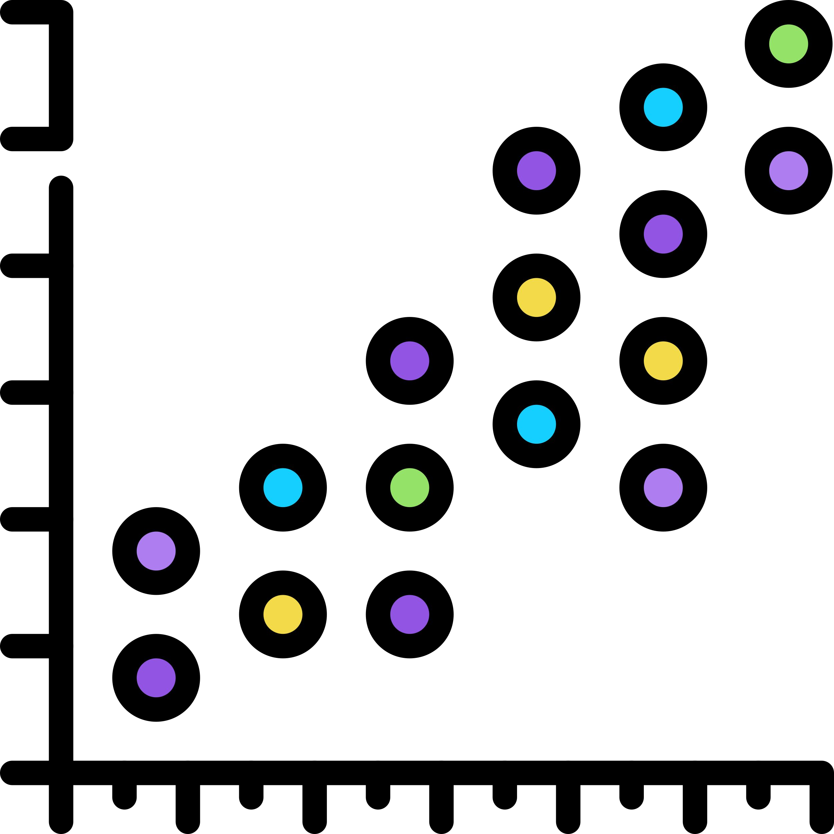



…
Numerical Analysis
Data Cleaning
Data Sourcing
Categorical Analysis
Derived Metrics

Slide 8





…
After collecting the data , the next step is data cleaning. Data cleaning means that you get rid of any information that doesn’t need to be there and clean up by mistake.
The following are some steps involve in Data Cleaning
Data Cleaning is the process of clean the data to improve the quality of the data for further data analysis and building a machine learning model.
Handle Missing Values
Standardization of the data
The benefit of data cleaning is that all the incorrect and irrelevant data is gone, and we get the good quality of data which will help in improving the accuracy of our machine learning model.
Outlier Treatment
Handle Invalid values

Slide 9




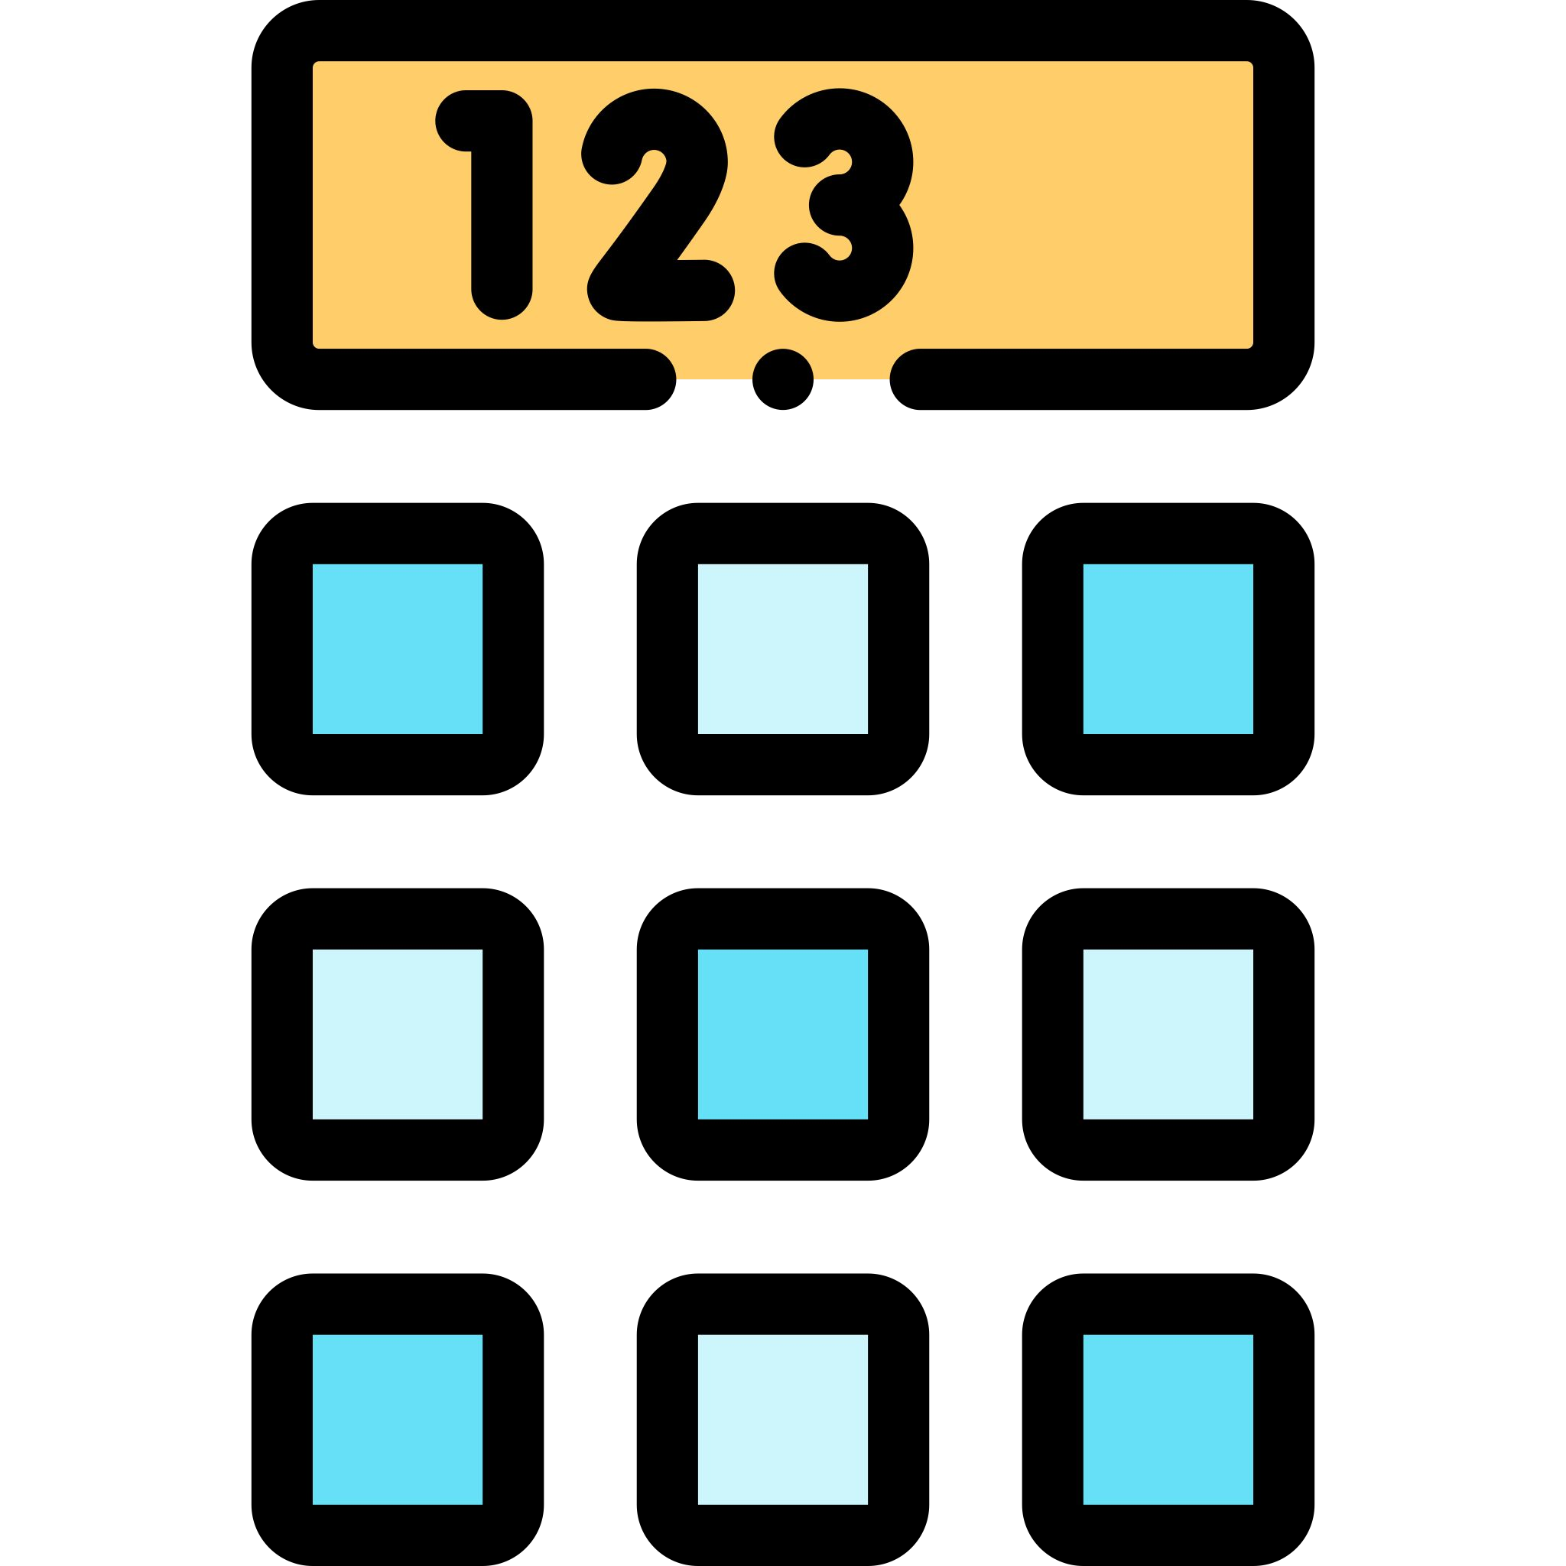
Some Questions you need to ask yourself about the data before cleaning the data
Does this data you’re looking at match the column labels?
Does this data make sense?
Does what you are reading make sense?
Does the data follow the rules for this field?
After computing the summarize statistics for numerical data, does it make sense?

Slide 10




Handle Missing Values
Delete Rows/Columns
Replacing with mean/ median/mode
Algorithm Imputation
Predicting the missing values
This method we commonly used to handle missing values. Rows can be deleted if it has insignificant number of missing value Columns can be delete if it has more than 75% of missing value
This method can be used on independent variable when it has numerical variables. On categorical feature we apply mode method to fill the missing value.
Some machine learning algorithm supports to handle missing value in the datasets. Like KNN, Naïve Bayes, Random forest.
Prediction model is one of the advanced method to handle missing values. In this method dataset with no missing value become training set and dataset with missing value become the test set and the missing values is treated as target variable.

Slide 11
Standardization/Feature Scaling

Slide 12

…
Importance of Feature Scaling
When we are dealing with independent variable or features that differ from each other in terms of range of values or units of the features, then we have to normalize/standardize the data so that the difference in range of values doesn’t affect the outcome of the data.
Feature scaling is the method to rescale the values present in the features. In feature scaling we convert the scale of different measurement into a single scale. It standardize the whole dataset in one range.

Slide 13
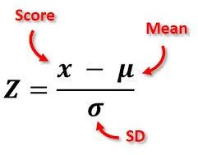
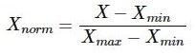
Feature Scaling Method.
Standard Scaler
Standard scaler ensures that for each feature, the mean is zero and the standard deviation is 1, bringing all feature to the same magnitude. In simple words Standardization helps you to scale down your feature based on the standard normal distribution
Min-Max Scaler
Normalization helps you to scale down your features between a range 0 to 1

Slide 14

Outlier Treatment
Outliers are the most extremes values in the data. It is an abnormal observations that deviate from the norm. Outliers do not fit in the normal behavior of the data.
Detect Outliers using following methods
Handle Outlier using following methods
Boxplot
Histogram
Scatter plot
Z-score
Inter quartile range(values out of 1.5 time of IQR)
Remove the outliers.
Replace outlier with suitable values by using following methods:-
Quantile method
Inter quartile range
Use that ML model which are not sensitive to outliers
Like:-KNN, Decision Tree, SVM, Naïve Bayes, Ensemble methods

Slide 15
Handle Invalid Value
Encode Unicode properly
Convert incorrect data types
Correct values that go beyond range
Correct wrong structure
In case the data is being read as junk characters, try to change encoding, E.g. CP1252 instead of UTF-8.
Correct the incorrect data types to the correct data types for ease of analysis. E.g. if numeric values are stored as strings, it would not be possible to calculate metrics such as mean, median, etc.
Some of the common data type corrections are — string to number: "12,300" to “12300”; string to date: "2013-Aug" to “2013/08”; number to string: “PIN Code 110001” to "110001"; etc.
If some of the values are beyond logical range, e.g. temperature less than -273° C (0° K), you would need to correct them as required.
A close look would help you check if there is scope for correction, or if the value needs to be removed.
Values that don’t follow a defined structure can be removed.
E.g. In a data set containing pin codes of Indian cities, a pin code of 12 digits would be an invalid value and needs to be removed. Similarly, a phone number of 12 digits would be an invalid value

Slide 16
Types of Data

Slide 17
Types of Data
Qualitative
Quantitative
A variable which able to describe quality of the population. (Categorical values)
A variable which quantify the population (Numerical values)
Nominal
Ordinal
Discrete
Continuous

Slide 18



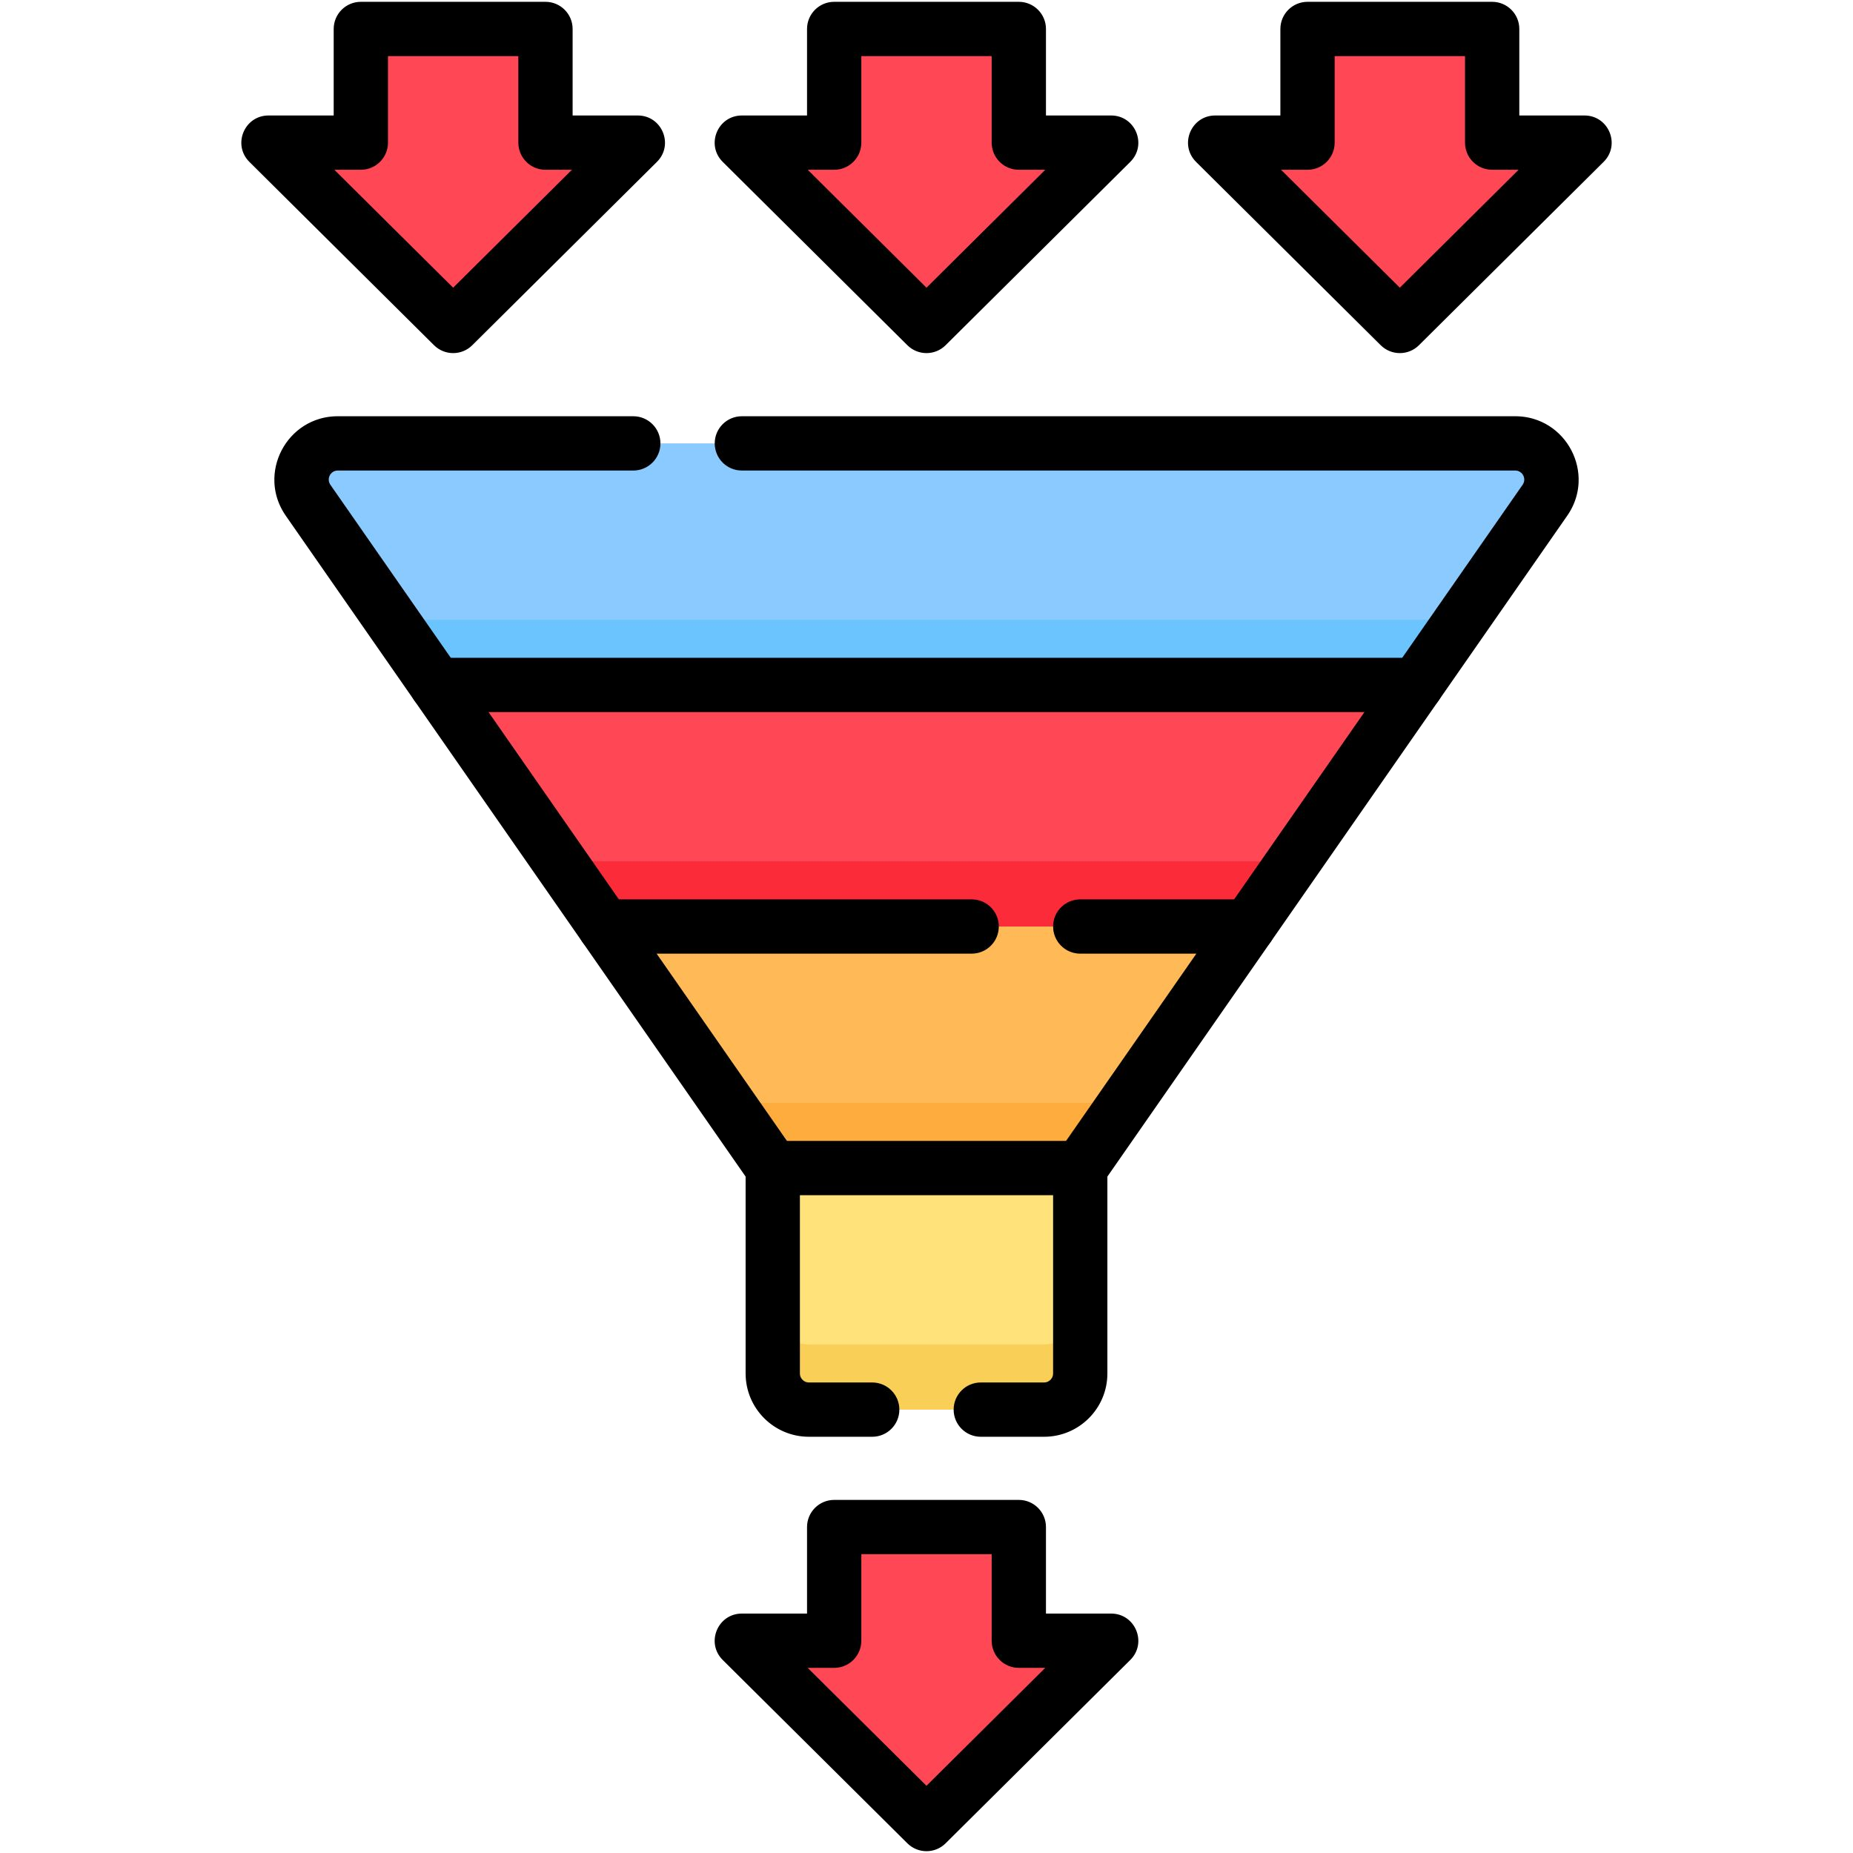
Types of Data
Discrete
Nominal
Continuous
Ordinal
It has a discrete value that means it take only counted value not a decimal values. Like count of student in class
It represent qualitative information without order. Value represent a discrete units.
Like Gender: Male/Female
,Eye colour.
A number within a range of a value is usually measured, such as height
It represent qualitative information with order. It indicate the measurement classification are different and can be ranked. Lets say Economic status: high/ medium /low which can ordered as low, medium, high.

Slide 19
Types of Analysis

Slide 20
Univariate Analysis
Univariate analysis is the simplest form of analyzing data.
“Uni” means “one”, so in other words your data has only one variable.

Slide 21
Bivariate Analysis
Data which has two variables, you often want to measure the relationship that exists between these two categorical variables.
Bivariate Analysis can also be performed with numerical values, or a combination of numerical & categorical values

Slide 22
Multivariate Analysis
Data which has more than two variables, you often want to measure the relationship that exists between these features

Slide 23
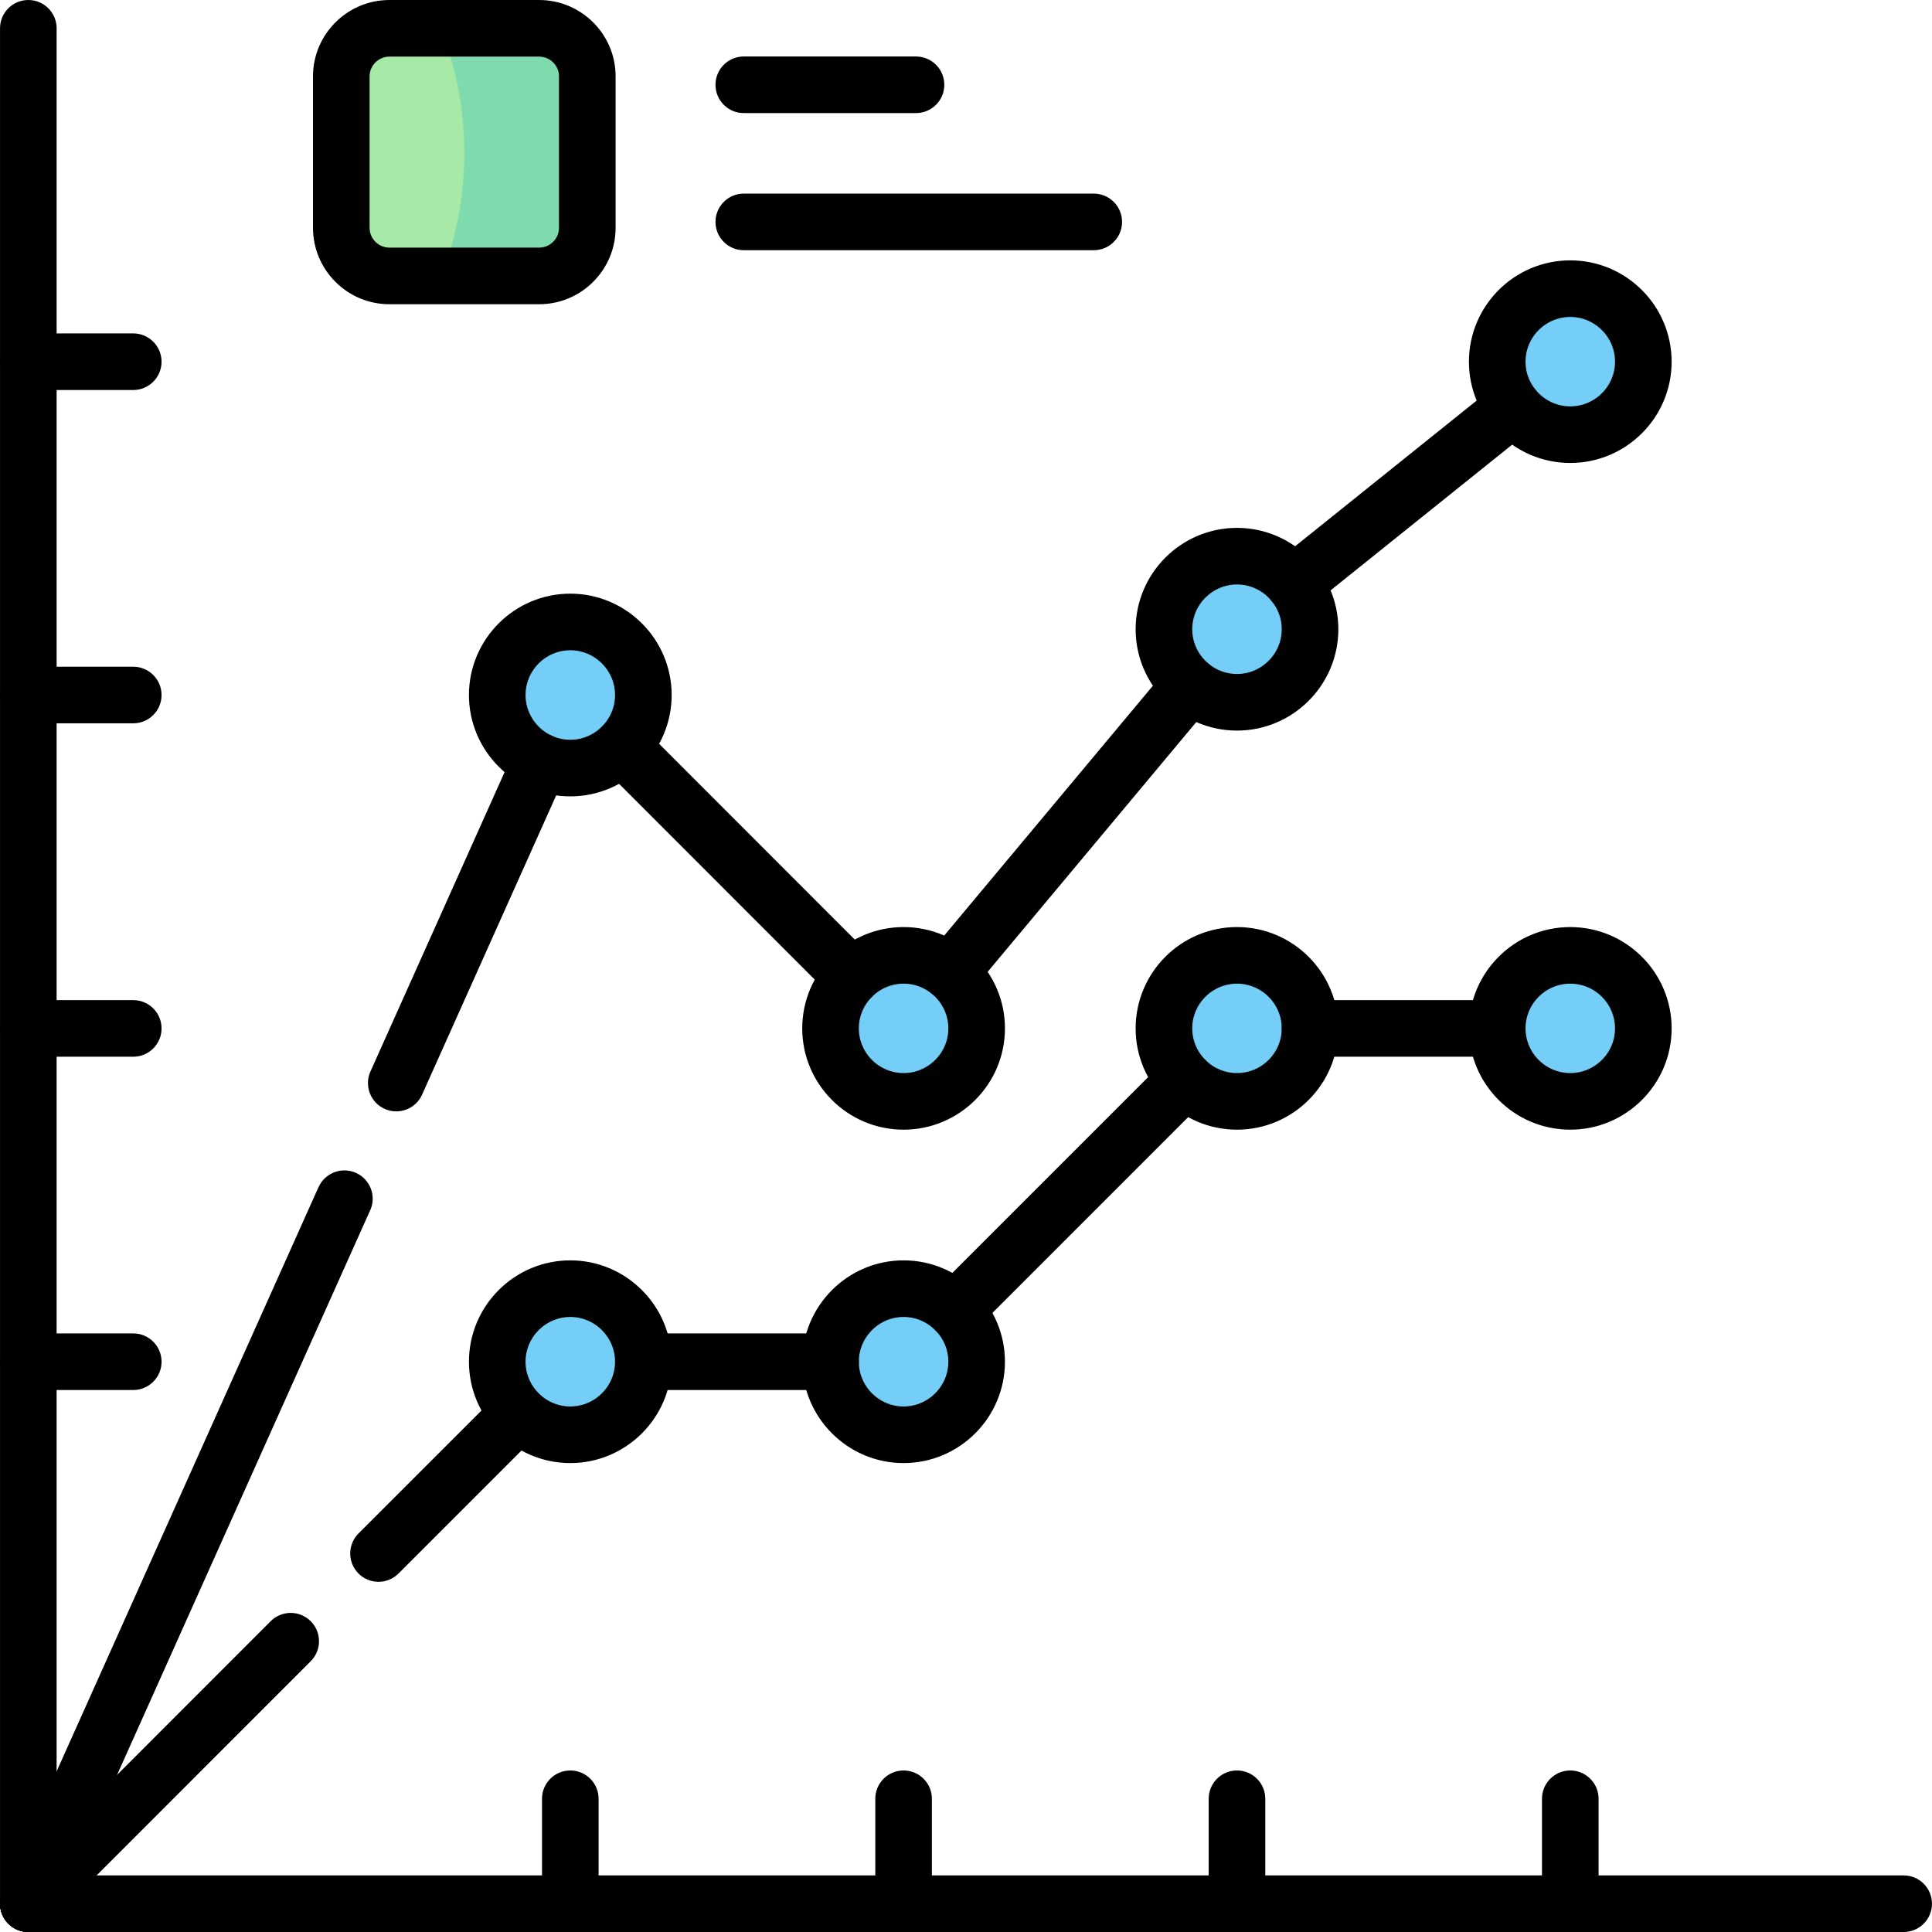

Numerical Analysis
We also perform various analysis over Numerical data.
Similarly, while analyzing multiple features, we might be interested in knowing their correlation with each other.
For example, dealing with a single numerical variable, we might be interested in knowing their statistical information such as mean, median, 25th Percentile, 75th Percentile,
min, max etc.

Slide 24
Derived Metrics
Derived metrics create a new variable from the existing variable to get a insightful information from the data by analyzing the data.
Feature Binning
Feature Encoding
From Domain Knowledge
.
Calculated from Data

Slide 25
Feature Binning
Feature binning converts or transform continuous/numeric variable to categorical variable. It can also be used to identify missing values or outliers.
Type of Binning
Equal width binning
Equal frequency binning

Slide 26
Feature Encoding
Feature encoding help us to transform categorical data into numeric data.
Label encoding
Label encoding is technique to transform categorical variables into numerical variables by assigning a numerical value to each of the categories.
One-Hot encoding
This technique is used when independent variables are nominal. It creates k different columns each for a category and replaces one column with 1 rest of the columns is 0.
Here, 0 represents the absence, and 1 represents the presence of that category.

Slide 27
Thank you

